Slide 1
Capstone Project
EDA on Global Terrorism

Slide 2
Content:-
1.Global Terrorism Analysis
1.Cleaning data. 2.Countries name where terrorist attack happened. 3.Knowing terror attack region wise. 4.Knowing the type of attack. 5.Knowing the target type. 6.Knowing the name of Gang involved in terror attack. 7.Knowing the type of weapon used in terror attacks. 8.Finally plotting graph using data visualisation. Conclusion

Slide 3
Problem statements:- 1.What were the weapon type generally used for attack. Generally explosives and firearms were used. 2.In which year most of the attacks occurred. Most of the attacks occurred in 2014 and 2015. 3.In which month the attacks were predominant. Each months have equal distribution. 4.Which country faced most of the terror attack. Iraq has highest number of attacks then Pakistan, Afghanistan and India follow it. 5.Which region faced most of the terror attack. Most of the attacks are done in Middle East and North Africa.

Slide 4
Data Summary:- Data set name:-Global Terrorism Analysis. Shape:-(181691,135) Column name:-Year,Month,Day,Country,State,Region,City,Attack_type,Target_type,Target_subtype,Gang_name,Weapon_type.

Slide 5
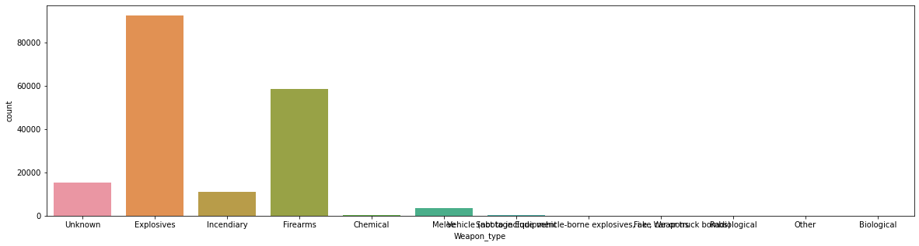
Weapons used in the attack:-

Slide 6
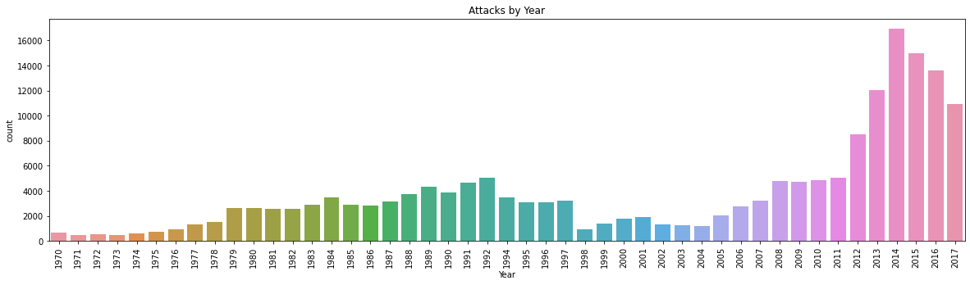
Analysing the terror attacks year wise:-

Slide 7
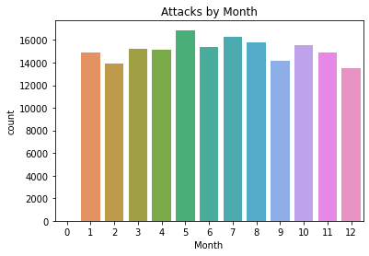
Analysing the terror attacks month wise:-

Slide 8
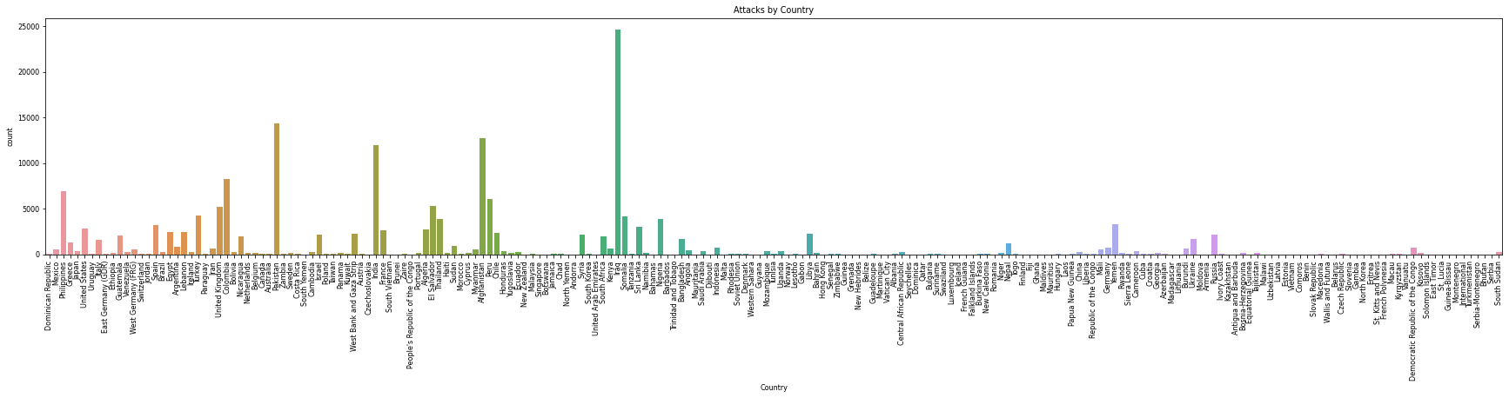
Analysing attack by country:-

Slide 9
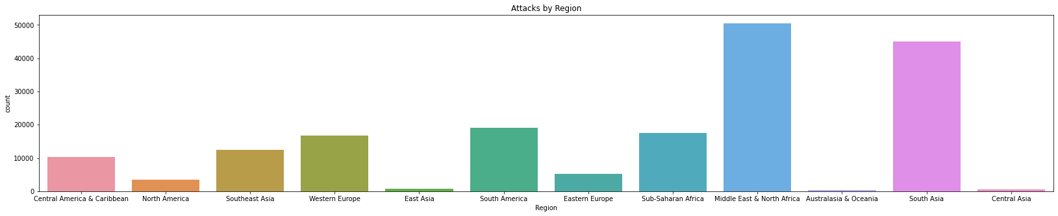
Analysing terror attacks by region wise:-

Slide 10
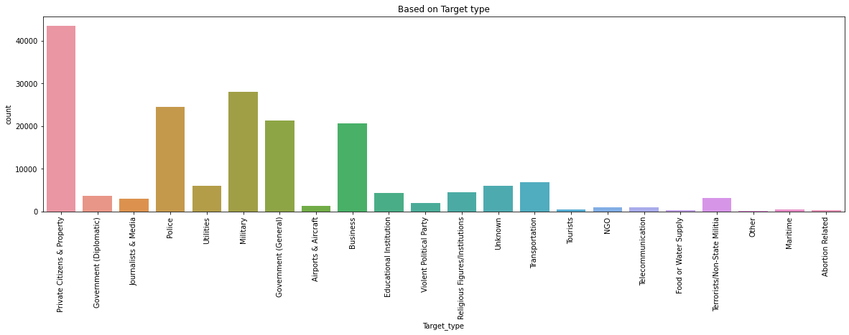
Analysing the terror attack by target type:-

Slide 11
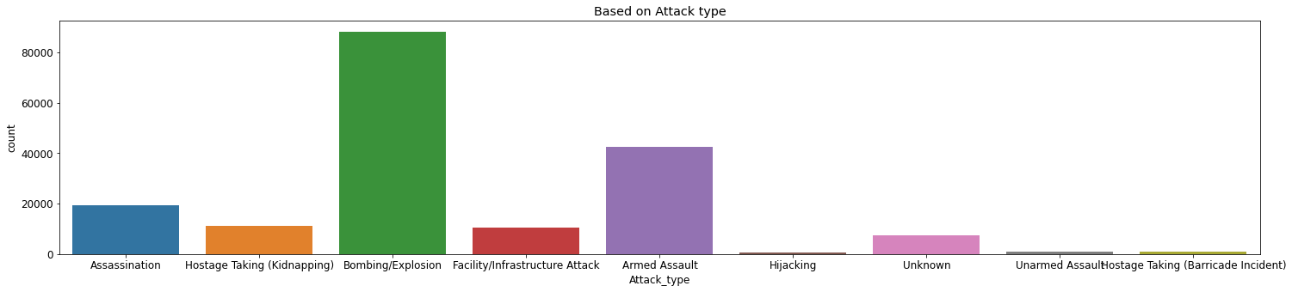
Analysing the type of attack:-

Slide 12
Conclusion:-
Results of Analysis
1. Most of the attacks were attacked through explosives and then through firearms.
2.Attacks were more during 2014 and then in 2015.
3.When compared to attacks from 1970 onwards, the last 6 years scored a maximum.
4.But from 2014 onwards count started decreasing.
5.Almost Every day has the same contribution, but attacks were low during 31st and high
during 15th and 1st.
6.Iraq dominates all the countries, and it has the highest number of attacks and then Pakistan,
Afghanistan, and India follow it.
7.The Middle East& North Africa leads 1st among all the regions and then South Asia takes
2nd place.
8.For most of the attacks, the target is Private Citizens& property and the next Military leads.
9.Most of the attacks were through either Bombing or Explosion.

